Slide 1

Telehealth’s value
to health systems
June 2017

Slide 2
Carena is redefining how consumers access care and providers deliver it.
We’re a team of medical, technology, and consumer service professionals committed to creating great patient experiences.
Confidential | 2

Slide 3







About us
Operating 34 virtual clinics
Serving 53 unique care programs
More than 158 hospitals
1M members in health plan programs
Licensed in 23 states
Commercial ACO and ACO
network support
Corporate relationships with national
systems & teaching institutions
Fortune 50 companies

Slide 4




We design and operate virtual clinics for health systems
BUILD
new relationships
CREATE
exceptional patient experiences
CONNECT
consumers to
their health
system
Confidential | 4

Slide 5
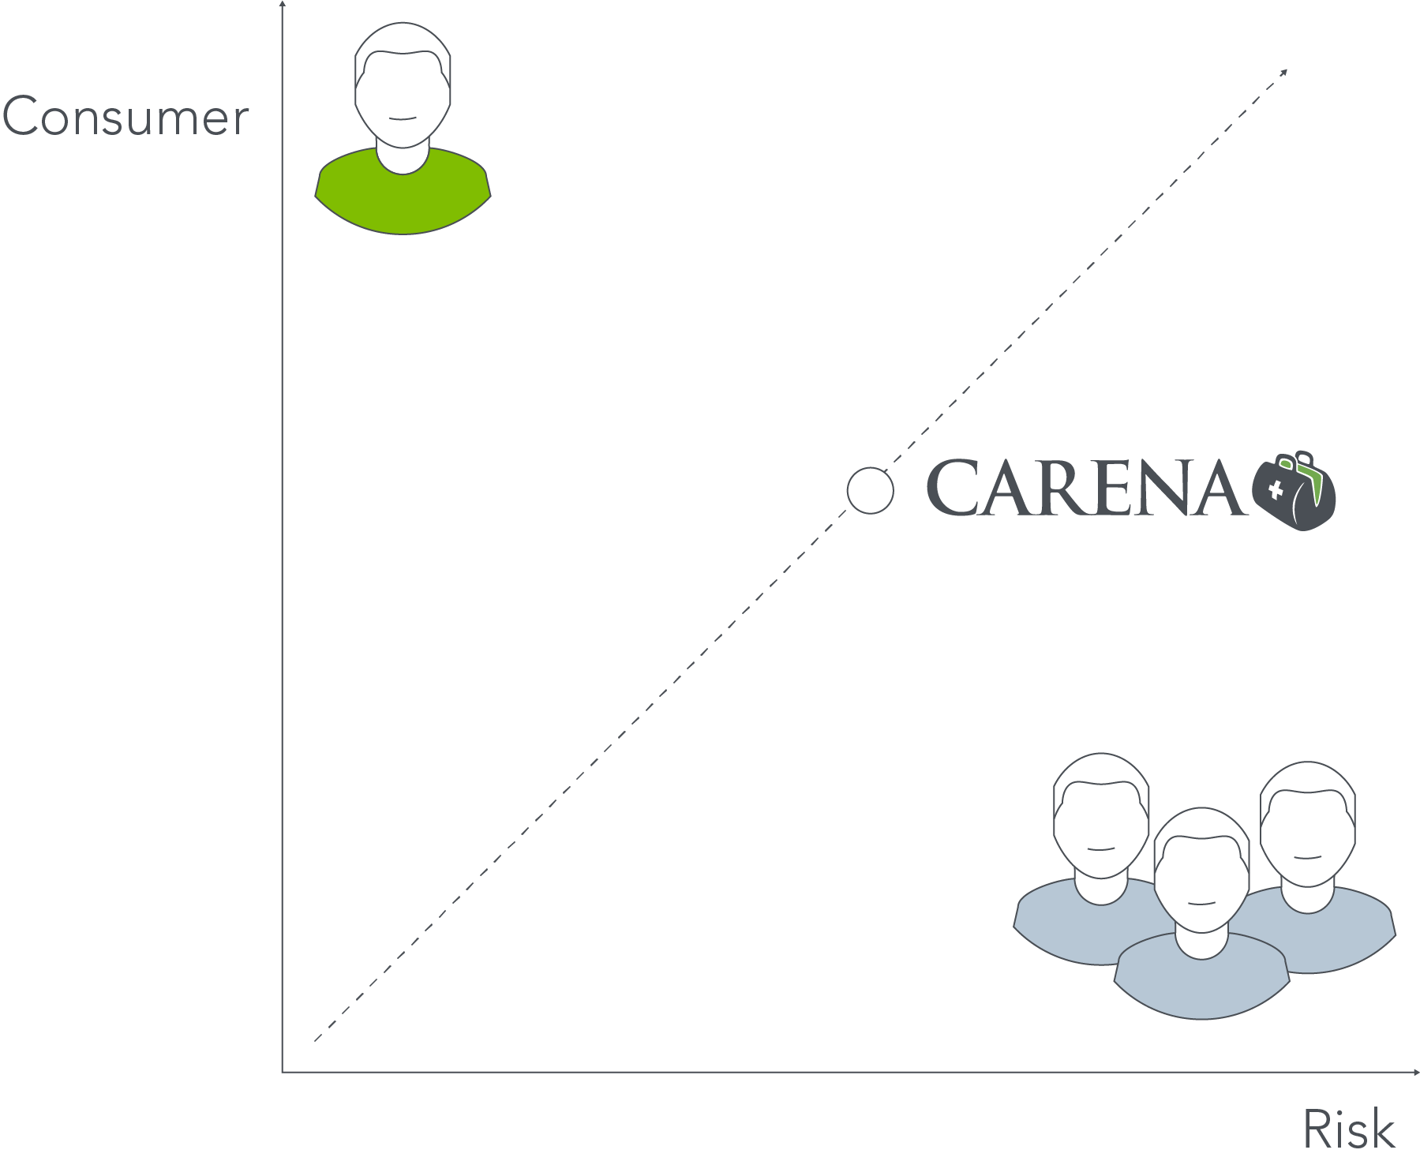
New era of access and delivery
    As high deductibles and co-pays rise, consumers value budget-friendly healthcare choices
    Self-insured employers expect healthcare that integrates with their plan
    Large government and commercial payers are accelerating the shift to fee-for-value payment
    Competition from non-system providers,
    such as retail & apps, is intensifying
    Expectations set by the internet that services
    are available on-demand, 24/7
Consumer
Risk

Slide 6

CHI Health-direct-to-employer
virtual care product suite
Partnered with more than 20 employers
in the Omaha area
    Develop a full employer health portfolio, driving revenue and ROI both directly and through downstream health system, CIN and/or health plan P&Ls
Deliver tailored high-tech, high-touch health solutions
29%
of employees on a HDHP plan in 2016. 8% increase from 2015.
Source: Kaiser Family Foundation, 2016 Employer Health Benefits Survey
Confidential | 6

Slide 7

Telehealth at the center of value-based care
1
Expanded Access—24/7/365 service to extended geographic area
2
Patient Engagement—consistent engagement through digital marketing
3
Preventive Health—programmatic care and engagement on patient’s terms
4
Care Coordination / Adherence—business & clinical workflows integrated into virtual clinic
Confidential | 5
Notes:
How it connects to virtual clinic globally-strategy (4 iniatiives)

Slide 8


Cost savings example in value-based telemedicine
A ‘package’ of virtual visits
can be scheduled shortly after discharge, when patient is at greatest risk for anxiety, complications, ED visit,
or readmission.
In 2015, Hospital XYZ paid a $400,000 penalty for having excess readmissions.
BY REDUCING
Pneumonia
readmissions about 10%
(from 6.9% to 6.2%)
✓
The Virtualist will follow specially-designed
post-discharge protocols.
$
YOU COULD BE SAVING
+
$133,000 to $200,000 in penalties
+ the actual costs of the readmission.
Confidential | 8
Notes:
Based on data from CMS
Expanded patient relationships
Client D* is starting a subscription-based ‘direct primary care’. Patients will use virtual care
Fee-for-value cost savings
Medicare penalizes hospitals for experiencing excess readmissions. Penalty is paid on all DRG payment reimbursements.
A targeted virtual care discharge program can reduce these readmissions. For example, a ‘package’ of virtual visits can be scheduled shortly after discharge, when patient is at greatest risk for anxiety, ED visit, or readmission. The Virtualist follows specially-designed post-discharge protocols.
Example: Hospital XYZ paid a $400,000 penalty in 2015 for having excess readmissions. We calculate that by reducing their pneumonia readmissions about 10% (from 6.9% to 6.2%) this could save $133,000 to $200,000 in penalties PLUS the actual costs of the readmission.
*Client D – medium size hospital in mid-size city

Slide 9
Adapting a virtual clinic for at-risk providers
SERVICE | OBJECTIVE
Design virtual clinic strategy | Improve access ED avoidance Close care gap System adoption
Integrate clinical treatment protocols (VPGs) | Medication management Readmission reductions Unplanned hospital admissions for heart & multi-chronic patients
Define multi-visit clinical and business protocols | Support with continuity care Build patient loyalty

Slide 10
Thank you.
RALPH C. DERRICKSON
President & CEO
Carena, Inc.
(206) 838-6864 office
Ralph.Derrickson@CarenaMD.com

